Slide 1




Coimbatore Institute of Technology
( An Autonomous Institution Affiliated to Anna University)
Audio Forgery Detection using Feed Forward Neural Networks and Multilayer Convolutional Neural Networks
01
An innovative Audio Authentication System

Slide 2

Group Members
and Guide
Abinandan.V - 1907001
Gokulram.M - 1907011
Sankarraj Aditya.M - 1907038
Srinivas. R - 1907049
Mrs.K. Malarvizhi
02
M.E
Assistant Professor

Slide 3

Motivation
The increase in low cost digital audio recorders, mobile applications and accelerating growth of the audio-based Internet of Things (IoT) has initiated ease in obtaining speech and audio data which will be later used for the purpose of identifying human traits, implementing voice authentication system and development of voice based embedded systems.
On the other hand, the availability of free advanced mobile applications and audio editing software like Adobe, Audition CC, etc. enabling people to edit easily the meaningful content of audio recordings data.
Perhaps, most of the people do it for fun as well as the strong intention of hiding reality present.

Slide 4




Project Objective
What we want to solve
With the rapid development of audio authentication systems, which is been part of authentication of mobiles to car doors. Audio Authentication is becoming very essential part of our lives. Audio Authentication Forgery is what we want to solve. Availability of high quality audio recorders in mobiles and native recorders enable bypassing this audio authentication system by just recording the human voice and reusing them for accessing the same system.
Hypothesis
We propose a Deep-Learning Enabled Audio Forgery Detector which uses Feed Forward Neural Nets and Convolutional Neural Networks at the backend to classify recordings and Human Voice

Slide 5
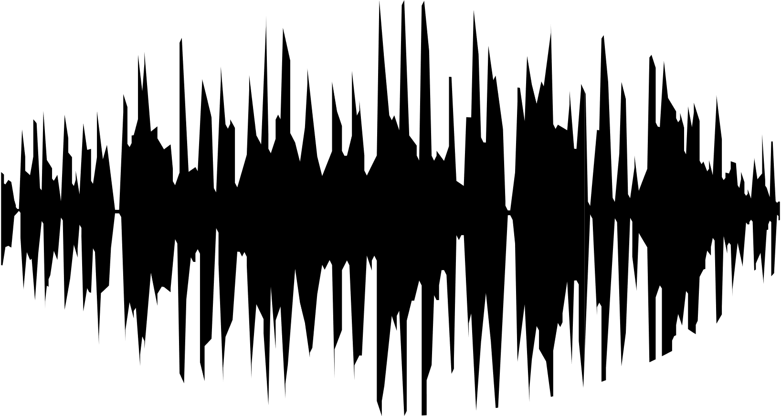
Abstract
of the project
Authentication has become very important aspect of our day today lives starting from normal lock screen pin to human retina based authentication systems. One among those popular and complex authentication systems are the audio based authentication systems where in people use certain words to unlock devices and objects like mobiles, doors etc., Audio Authentication generally involves authentication based on words and voices. Issue in the existing system is that the system verifies and extracts the features of words and voices but it does not classify human voice and recorded human voices. We use LSTMs and Convolutional Neural Networks to achieve this. This project can also be used in various different areas, starting from mobile unlocking system to car door unlocking system.
This Deep Learning model can be deployed and used alongside the audio authentication system to classify recorded voices from human voices.

Slide 6

Literature Survey
Journals Referred :
IEEE - Institute of Electrical and Electronics Engineers
Science Direct
ACM
Research Gate
Research findings
and highlights

Slide 7
Sno
Title
Author
Methodology
Limitations
Journal
Detection of Various Speech Forgery Operations
Based on Recurrent Neural Network
Diqun Yan
Tingting Wu
An RNN
frame with two-layer LSTM is designed with preliminary experiments. Extensive
experiments on TIMIT and UME databases.
The Forensic algorithm proposed in this method is only limited to four kind of common forgery operations.
Research Gate
1
Detection of impostor and tampered segments in audio by using an
intelligent system
Zeshan Mubeen, Mehtab Afzal, Zulfiqar Ali, Suleman Khan
A State-of-the-art
mel-frequency cepstral coefficient features were implemented in this system.A Gaussian mixture model is used to train and validate the system
IoT Application proposed in this journal is very expensive to implement and Algorithm used is very complex.
2
Science
Direct

Slide 8
Sno
Title
Author
Methodology
Limitations
Journal
Akhilesh Halageri , Amrita Bidappa , Arjun C , Madan Mukund Sarathy
It involves capturing and digitizing sound waves, converting to basic language units or phonemes, constructing words from phonemes by applying Mel filterbank.
It is expensive in terms of both memory and Compute time.
May Overfit for Large Datasets
3
Speech Recognition using Deep Learning
IJCSIT
Shift-recompression method is used to retrieve differential features between the re-encoded audio
Learning classifier is employed to recognize different patterns.
Shift recompression method is only limited to AAC file format.
Qingzhong Liu,Andrew Sung,Lei Chen,Ming Yang,Zhongxue Chen
A Method to Detect AAC Audio Forgery
Research
Gate
4

Slide 9
Sno
Title
Author
Methodology
Limitations
Journal
Katz algorithm is used to detect the VAD by Fractal dimension Estimation.
It only detects the speech-presence and speech-absence segments of an audio and Accuracy is comparitively low.
Unsupervised Voice Activity Detection and Classification
of Audio Segments
Zulfiqar
Ali, Muhammad Talha
5
IEEE
The proposed model Alex-Net with five convolutional layers and two fully connected layers acquire most vital features form spectrogram images plotted on the amplitude-frequency scale. Accuracy 80 %
Obtaining Mel - Frequency is slightly complex
Fusion Based AER System Using Deep Learning Approach for Amplitude and Frequency Analysis (2021)
A. Pramod Reddy
Vijayarajan V.
ACM
6

Slide 10
Sno
Title
Author
Methodology
Limitations
Journal
Voice Recognition and Voice Comparison using Machine Learning Techniques (2020)
Nishtha H. Tandel,
Harshadkumar B Prajapati,
Vipul
Dabhi
Proposes a Self-constructed LSTM along with multi-layer CNN for Audio classification
No details about audio classification between human voice and recordings
7
Research Gate
A novel deep learning model to detect COVID-19 based on wavelet features extracted from Mel-scale spectrogram of patients’ cough and breathing sounds (2022)
Makes use of Mel-frequency Spectrogram and other techniques to analyze frequencies of audio.
Classification based on CNN is detailed which is essential for the given use case
Mohammed Aly a,
Nouf Saeed Alotaibi b
8
Science Direct

Slide 11
Sno
Title
Author
Methodology
Limitations
Journal
Made use of Mel frequency Ceptral coefficients to classify audio events and spectrograms are also used. These data are processed and trained using DNN
Analysis of machine learning algorithms for audio event classification using Mel-frequency cepstral coefficients (2021)
DNN does not provide attractive accuracies on test data
9
J.Sangeethaa R.
Hariprasad
b
S.Subhikshac
Science Direct
Design of an integrated learning approach to assist real-time deaf application using voice recognition system (2021)
Here, metrics like accuracy, precision, F1-score, recall, kappa coefficient, MAE, and MCC are evaluated to show the model's significance. Mel filter is also used
Arun Prasath G
Annapurani Panaiyappan K
No information about data used and data processing techniques and no use of CNN for Mel-frequency spectrum classification
10
Science Direct

Slide 12
Sno
Title
Author
Methodology
Limitations
Journal
Frequency Domain Analysis for Audio Data Forgery Detection (2019)
Dharmesh Namdev, Ashish Bansal
Dataset used contains raw audio files without voices which is not appreciated for our usecase
In order to find the properties of audio
files the input wav file is pre-processed and then processed
with the help of Fourier transform.
11
IEEE
Audio Forgery Detection Techniques:
Present and Past Review
The speech activity detection technique is used to find voiced and unvoiced regions of the speech signal to decide at which
location the splice segment of another audio is assembled
One of the main challenges faced by the researcher during the evalu -ation of a forgery detection algorithm is the lack of publicly available and ready to use dataset.
Prabhu R. Bevinam
arad, M.S.
Shirldonkar
IEEE
12

Slide 13
Sno
Title
Author
Methodology
Limitations
Journal
TRANSFORMER-BASED ONLINE CTC/ATTENTION END-TO-END SPEECH
RECOGNITION ARCHITECTURE
Haoran Miao1, Gaofeng Cheng, Changfeng Gao,
In this paper, ASR architecture is discussed. On the SAE aspect, we
propose the chunk-SAE which splits the input speech into isolated chunks of fixed length
Highly complex model when compared to LSTM based model
13
IEEE
The mainstream method uses the multi-condition
training (MCT) to boost the noise robustness of ASR. MCTuses different kinds of data to train the speech recognition model.
Only clean data is taken into account unclean data were taken into account
Gated Recurrent Fusion With Joint Training
Framework for Robust End-to-End
Speech Recognition
Cunhang Fan
IEEE
14

Slide 14
Sno
Title
Author
Methodology
Limitations
Journal
CEGM-optimized speech enhancement
could effectively reduce theWERon theCHiME-4real test setwhen
compared to unprocessed noisy speech and enhanced speech obtained
with MMSE-optimized enhancement for ASR systems with
fixed multi-condition acoustic models in various deep architectures
A Cross-Entropy-Guided Measure (CEGM) for
Assessing Speech Recognition Performance and
Optimizing DNN-Based Speech Enhancement
Li Chai , Jun Du , Qing-Feng Liu, and Chin-Hui Lee
Makes use of DNN which is pretty outdated for speech recognition
IEEE
15

Slide 15

References
1) Yan, Diqun, and Tingting Wu. "Detection of various speech forgery operations based on recurrent neural network." International Conference on Security and Privacy in Digital Economy. Springer, Singapore, 2020.
2) Mubeen, Zeshan, et al. "Detection of impostor and tampered segments in audio by using an intelligent system." Computers & Electrical Engineering 91 (2021): 107122.
19
3) Nassif, Ali Bou, et al. "Speech recognition using deep neural networks: A systematic review." IEEE access 7 (2019): 19143-19165
4) Liu, Qingzhong, et al. "A method to detect AAC audio forgery." EAI Endorsed Transactions on Security and Safety 15.6 (2015): 1.

Slide 16
References
5) Ali, Zulfiqar, and Muhammad Talha. "Innovative method for unsupervised voice activity detection and classification of audio segments." Ieee Access 6 (2018): 15494-15504
6) Reddy, A. Pramod. "Fusion Based AER System Using Deep Learning Approach for Amplitude and Frequency Analysis." Transactions on Asian and Low-Resource Language Information Processing 21.3 (2021): 1-19.
.
.
7) Tandel, Nishtha H., Harshadkumar B. Prajapati, and Vipul K. Dabhi. "Voice recognition and voice comparison using machine learning techniques: A survey." 2020 6th International Conference on Advanced Computing and Communication Systems (ICACCS). IEEE, 2020.
8) Aly, Mohammed, and Nouf Saeed Alotaibi. "A novel deep learning model to detect COVID-19 based on wavelet features extracted from Mel-scale spectrogram of patients’ cough and breathing sounds." Informatics in Medicine Unlocked (2022): 101049.

Slide 17
References
9) Sangeetha, J., R. Hariprasad, and S. Subhiksha. "Analysis of machine learning algorithms for audio event classification using Mel-frequency cepstral coefficients." Applied Speech Processing. Academic Press, 2021. 175-189.
10) Prasath, Arun. "Design of an integrated learning approach to assist real-time deaf application using voice recognition system." Computers and Electrical Engineering 102 (2022): 108145.
11) Namdev, Dharmesh, and Ahsish Bansal. "Frequency domain analysis for audio data forgery detection." 2015 Fifth International Conference on Communication Systems and Network Technologies. IEEE, 2015.
12) Bevinamarad, Prabhu R., and M. S. Shirldonkar. "Audio Forgery detection techniques: present and past review." 2020 4th International Conference on Trends in Electronics and Informatics (ICOEI)(48184). IEEE, 2020.

Slide 18
References
13) Miao, Haoran, et al. "Transformer-based online CTC/attention end-to-end speech recognition architecture." ICASSP 2020-2020 IEEE International Conference on Acoustics, Speech and Signal Processing (ICASSP). IEEE, 2020.
14) Fan, Cunhang, et al. "Gated recurrent fusion with joint training framework for robust end-to-end speech recognition." IEEE/ACM Transactions on Audio, Speech, and Language Processing 29 (2020): 198-209.
15) Chai, Li, et al. "A cross-entropy-guided measure (cegm) for assessing speech recognition performance and optimizing dnn-based speech enhancement." IEEE/ACM Transactions on Audio, Speech, and Language Processing 29 (2020): 106-117.

Slide 19

Thank you

